Slide 1
Research for waveform
Binjue Wu

Slide 2
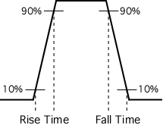
Rise time and fall time
In electronic, rise time refers to the time required for a signal to change from a specified low value to a specified high value, when describing a voltage or current step function.
fall time (pulse decay time) is the time required for the amplitude of a pulse to decrease (fall) from a specified value to another specified value.

Slide 3

Calculation of rise time and fall time
Two peaks in waveform

Slide 4
Discrete Fourier Transform
It is a specific kind of discrete transform, used in Fourier analysis
It transforms one function into another (frequency domain representation), or simply the DFT, of the original function (which is often a function in the time domain).
Notes:
Input has to be continuous function, however, it must have a limited duration

Slide 5

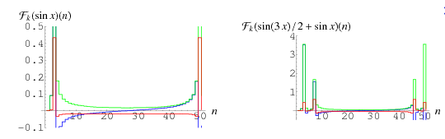
Calculation for DFT

Slide 6
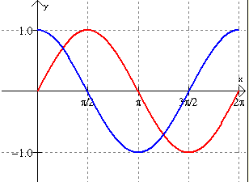
Phase shift
Phase shift is any change that occurs in the phase of one quantity, or in the phase difference between two or more quantities.

Slide 7
Power Factor
The power factor of an electrical power system is defined as the ratio of the real power flowing to the load to the apparent power in the circuit.
Real power is the capacity of the circuit for performing work in a particular time. Apparent power is the product of the current and voltage of the circuit.

Slide 8

Calculation for power factor
In an electric power system, a load with a low power factor draws more current than a load with a high power factor for the same amount of useful power transferred.

